Slide 1
Machine Learning
Instructor
Notes:
https://www.youtube.com/watch?v=GwIo3gDZCVQ

Slide 2
Class-1: Introduction to ML
Type of ML:
Supervised Learning
knowing X and Y, generate a model to classification
Unsupervised Learning
knowing X but Y, generate a model to cluster
Reinforcement Learning
knowing X but Y, create an environment and learning agent

Slide 3
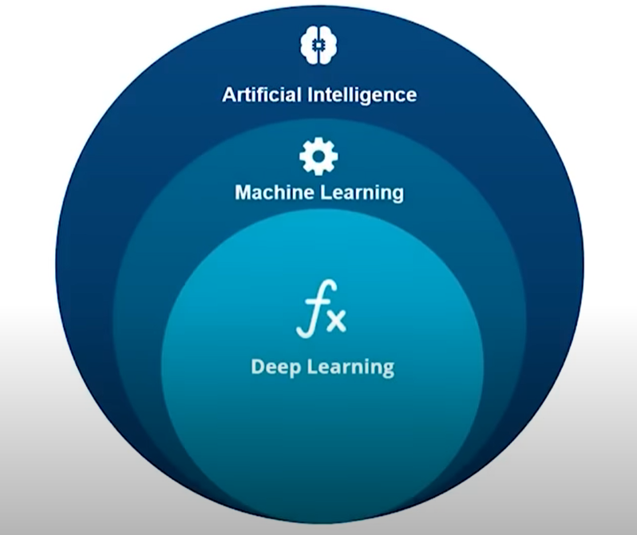
Class-1: AI vs ML vs Deep Learning
1950s-1970s - AI
Example of AI
1980s – 1990s - ML
Example of ML
2000s -2010s – DL - ANN
Artificial/Deep Neural Network
Example of Deep Learning

Slide 4
Class-1:Classification of Algorithm
Anomaly Detection Algorithm
Clustering Algorithm
Regression Algorithm
Demo: Iris Dataset
Stats & Probability for Machine Learning
Categories of Data
Qualitative Data
Quantitative Data
What is Statistics?
Statistics Terminologies

Slide 5
Content
Sampling Techniques
Random Sampling
Systematic Sampling
Stratified Sampling
Types of Statistics
Descriptive Statistics
Measures of Spread
Information Gain & Entropy
Confusion Matrix

Slide 6
Content
Probability
Probability Terminologies
Types of Events
Probability of Distribution
Types of Probability
Marginal Probability
Joint Probability
Conditional Probability
Use-Case
Bayes Theorem
Inferential Statistics
Point Estimation
Interval Estimate
Margin of Error
Hypothesis Testing

Slide 7
Content
Supervised Learning Algorithms
Regression
Linear vs Logistic Regression
Understanding Linear Regression Algorithm
Logistic Regression Curve
Titanic Data Analysis
Decision Tree
What is Classification?
Types of Classification
Decision Tree
Decision Tree Terminologies
Entropy
Credit Risk Detection Use-case

Slide 8
Content
Random Forest
Random Forest Use-Cases
Random Forest Algorithm
KNN Algorithm
KNN Algorithm Working
KNN Demo
Naive Bayes
Naive Bayes Working
Industrial Use of Naive Bayes
Types of Naive Bayes
Steps involved in Naive Bayes
PIMA Diabetic Test Use Case
Support Vector Machine
Non-Linear SVM
SVM Use-case

Slide 9
Content
K-Means Clustering & Association Rule Mining
Types of Clustering
K-Means Clustering
K-Means Working
Pros & Cons of K-Means Clustering
K-Means Demo
Hierarchical Clustering
Association Rule Mining
Apriori Algorithm
Apriori Algorithm Demo
Reinforcement Learning
Reinforcement Learning: Counter-Strike Example
Markov's Decision Process

Slide 10
Content
Q-Learning
The Bellman Equation
Transitioning to Q-Learning
Implementing Q-Learning
Machine Learning Projects
Who is a ML Engineer?
ML Engineer Job Trends
ML Engineer Salary Trends
ML Engineer Skills
ML Engineer Job Description
ML Engineer Resume
Machine Learning Interview Questions

